Slide 1
Lecture 1: Computer arithmetics

Slide 2
Course structure
We use LISAM(accessed via Student portal)
Lectures
Labs (computer). Deadlines, approximately a week after lab session
Individual report, group report.
Seminars – obligatory attendance
Speaker groups
Opponent groups
One written final exam (computer)
Course book: Computational statistics by J.E. Gentle.

Slide 3
Computational statistics
Statistical analysis is often complex, paper and pen is often not enough -> computer assistance is needed
In computational statistics, we answer questions like:
How to implement statistical procedures that we do not get problems like overflow?
How do we generate a random variable, several correlated variables, variables coming from some multivariate distribution?
How to compute maximum likelihood numerically?
How to compute confidence (credible) intervals for complex distributions when deriving formulas is not helping?

Slide 4
Course contents
Computer Arithmetics
Optimization
Random number generation
Monte Carlo methods, MCMC
Numerical model selection and hypothesis testing
EM algorithm and stochastic optimization

Slide 5
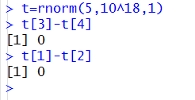
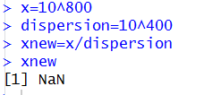
Why statisticians need to think of computer arithmetics?
Magnitude of numbers affects many statistical computations:

Slide 6
Data presentation and measures
Computer data is stored in binary form (bits)
1 Byte=8bit (typical unit!)
1 Word = 32 or 64 bit (depend on comp)
1KB=1024bytes
1MB=1024 KB
…
0 | 1 | 1 | 0 | 1 | 1 | 0 | 1

Slide 7
Characters
ASCII (American standard code for information exchange)
Each character – 1 byte (totally 2⁸ characters)
English letters+arabic numerals+punctuation
Unicode
Each character – 2 bytes
Variety of languages

Slide 8
Fixed-point (integer) system
Each integer can be represented as a sequence of bits: A=a₀2⁰+a₁2¹+a₂2²+…. Try with A=5 !
Integer may occupy a word, half of word or double word
Negative numbers:
Leading bit: first bit=1 if negative (easy)
Two’s complement (short numbers): 8=00001000 , -8=11110111+1=11111000
Try to add +8 and -8!
If k bits used, range becomes [-2^{k-1},2^{k-1}-1]

Slide 9
Arithmetic operations
Addition, multiplication: work with bits
Substraction: A-B= A+ (-B)
Division: Is not easy to do, rounded towards zero
Overflow: If adding two large numbers, sign bit can be treated as high order bit, in some (old) architectures resulted in a negative number!

Slide 10
Floating-point system
Sign
Exponent
Mantissa=Significand
± 0.d1d2…d_{p}*b^{e}
Values to be presented approx [-10³⁰⁰,10³⁰⁰]
sign (1bit) | Exponent (11bits) | Mantissa (52 bits)

Slide 11
Floating-point system
Real numbers are not the same as computer floats!! But they are instead rounded towards floats…
Ex.: Assume there are only 5 digits for mantissa, number 4.0000567 becomes 0.40000*10¹
In most computer systems, base is 2, not 10, but the problem remains.
How computer floats are distributed
Very dense from -1 to 1, density decreases. If N points for numbers having exponent *10¹, also N points for numbers with exponent 10³

Slide 12
Special floating-point numbers
Usually maximal allowed number in the exponent is one unit less than it could be
± Inf : exponent is exp_{max}+1 and mantissa is zero
NaN: exponent is exp_{max}+1 and mantissa is nonzero
Overflow/underflow:
10²⁰⁰*10²⁰⁰=+Inf
10⁴⁰⁰/10⁴⁰⁰=Inf/Inf=NaN
10⁻²⁰⁰/10²⁰⁰=0
0*10⁴⁰⁰=?
If x:=x+1, the cycle will NOT converge to +Inf !

Slide 13
Operations on real numbers and floats
Since floats are not the same as real numbers, usual mathematical laws may break down.
Ex: 1/3+1/3=2/3 where in computer 0.33333+0.33333≠0.66667
However, most of computer systems are designed to make arithmetic operations as correct as possible

Slide 14
Operations on real numbers and floats
More problems with floats:
Results of X*Y and X+Y do not result in a true value (overflow for ex.)
A+X=B+X but B ≠A
A+X=X but A+Y ≠Y
A+X=X but X-X ≠a
-> BE CAREFUL WHEN YOU COMPARE NUMBERS IN COMPUTER!
Associativity and distributivity may not hold

Slide 15
Summation problem
Recall x:=x+1, similar problem may occur when summing arbitrary data series.
Solution A:
Sort the numbers ascending
Sum up numbers in this order
Solution B (similar magnitude):
Sum numbers pairwise, having n numbers obtain n/2 numbers
Continue until you have 1 number

Slide 16
Cancellation
If computing exponent using Taylor series
e^{x}=1+x+x²/2+x³/6+…
If x=20, the formula works fine
If x=-20, the error is almost 100%
Main reason: varying sign of the terms
Cancellation = adding two numbers almost equal magnitude, opposite sign
Here, effects of small cancellations accumulated

Slide 17
Computer arithmetics in matrix computations
Very often, one needs to solve (ex: regression)
Ax=b
A matrix
X unknown vector
b vector of scalars
Requirement
The algorithm solving the problem should be numerically stable

Slide 18
Linear regression models
Minimize
Solve the equation system that can be written
where is a matrix of observed x-variables

Slide 19
Smoothing splines
Minimize
Solution is
where θ is found from

Slide 20





Solving system of linear equations
Important to be able to solve Ax=b numerically
Aware of computer arithmetics! (recall a+x=x)
Condition number
Original system
Perturbed system
Solution is good if small perturbation of b causes small perturbation of x, and since

Slide 21


Solving system of linear equations
Condition number
Properties:
Large condition number is a bad signal, but does not imply ill-conditioning
If norm is L₂ then k is ratio of max.eigenvalue and min.eigenvalue
Since problems in regression fitting may appear

Slide 22
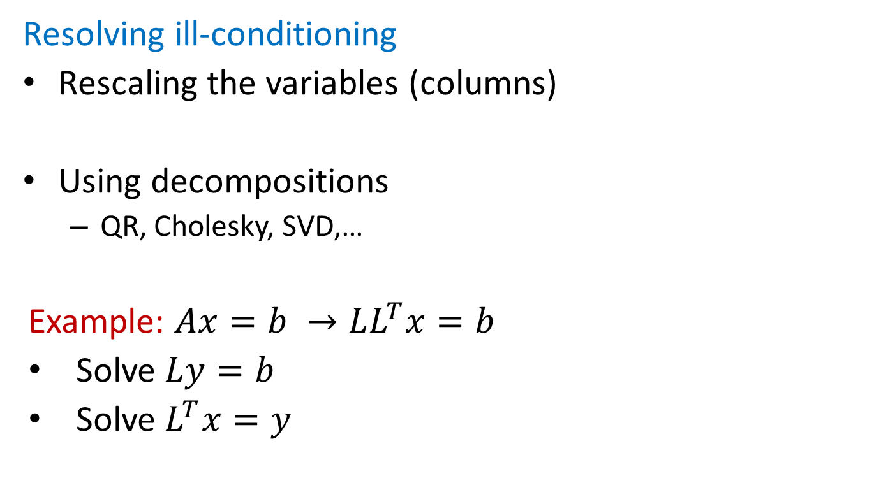
Solving system of linear equations
Resolving ill-conditioning
Rescaling the variables (columns)
Using decompositions
QR, Cholesky, SVD,…
Example: $Ax=b →LL^{T}x=b$
Solve $Ly=b$
Solve $L^{T}x=y$

